Slide 1
COS30045 Project Stand Up 2
Topic: Hospitalised Injuries from Road Crashes in Australia
By: AKHILA G

Slide 2
Visualisation Purpose
Target Audience:
Policymakers & public health researchers · Road safety organisations · General public & journalists
Q1
Trends Over Time
Q2
Age Group Differences
How have hospitalisation numbers for First Nations peoples changed each year from 2011–2021, and how does this compare to non-Indigenous Australians?
Which age groups have the highest hospitalisations among First Nations peoples — is it young adults (17–25) or other cohorts?
Q3
Location & Remoteness
Q4
Road User Types
Do patterns differ between Major Cities, Regional, and Remote areas for First Nations peoples?
Which road users (car occupants, motorcyclists, pedestrians) are most often hospitalised, and has this changed over 11 years?

Slide 3
Visualisation Design
Chart Types Chosen
Design Principles
Line Chart
Graphical Integrity
Trends 2011–2021. Two lines (First Nations vs non-Indigenous) — gap communicates disparity directly.
Axes start at zero. Each chart notes counts are not population-normalised — NT vs VIC comparisons can otherwise mislead.
Grouped Bar Chart
Accessibility
Age group & road user breakdowns — ordinal categories, not continuous. Direct side-by-side comparison.
Navy/amber palette (colourblind-safe, avoids red/green). Body text ≥14pt. WCAG AA contrast standards met.
Horizontal Bar Chart
Cultural Sensitivity
Remoteness — long labels read better on a horizontal axis.
First Nations data presented respectfully — no deficit framing. Follows AIHW Indigenous data guidelines.
Stacked Bar Chart
Road user share by year — shows both total count and composition without misleading pie slices.
Draft colour palette (colourblind-safe):
Navy / First Nations
Amber / Non-Indigenous
Teal / Accent
Slate / Grid

Slide 4
Interaction Design
Toggle buttons - filter by Indigenous status (All / First Nations / Non-Indigenous) → all charts update at once
Checkboxes - filter by road user type → line chart shows/hides selected series
Year slider - drag to select year 2011–2021 → stacked bar chart updates
Hover tooltips - on every chart → shows group name, year, exact count
Click to highlight - click a line on the line chart → other line fades to low opacity
Smooth transitions - 300ms ease animation so users can see what changed
User Action | System Response
Click “First Nations only” | All charts redraw for that group only
Drag the year slider to 2021 | Stacked bar updates to 2021 data
Hovers over a bar | Tooltip shows exact count

Slide 5


Website Design
Layout: Single-page scrolling website, fixed nav bar at top
Page sections (top to bottom):
Fixed Nav Bar - title left, links right: Introduction | Trends | Breakdown | About
Hero Section - 3 key stat callouts: ~45,000/yr , 3× higher rate , 90% increase
Trends Section - full-width line chart + filter controls above
Breakdown Section - grouped bar (age) + horizontal bar (remoteness) side by side
Road User Section - stacked bar + year slider
Footer - BITRE credit, team name, unit code
Design rationale: Single-page keeps users on a linear story. No clicking between pages so it reduces confusion for general audience.

Slide 6
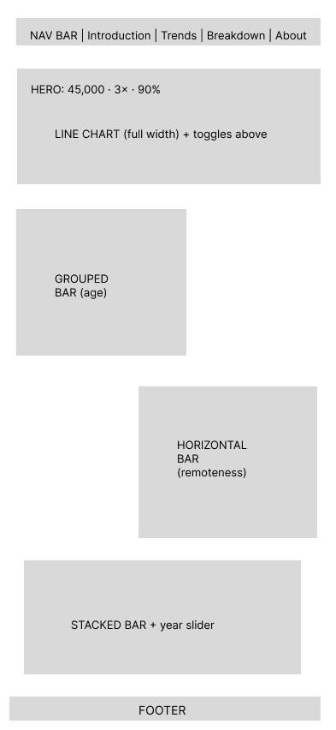
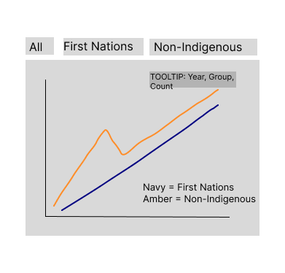
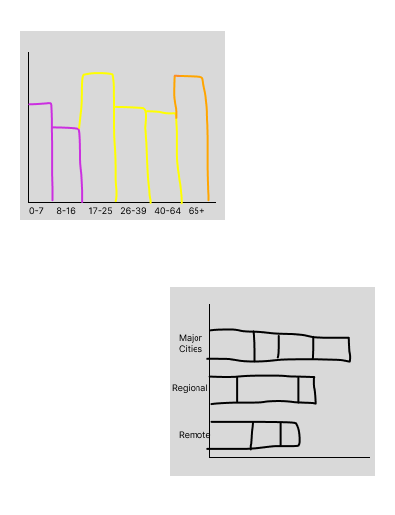
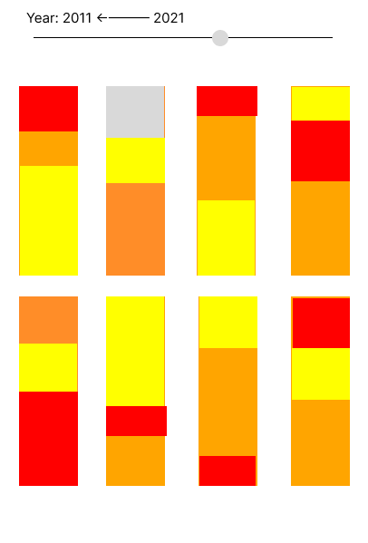
Sketches – Prototypes & Wireframes
Wireframes see below: created in Figma - showing page layout and individual chart designs
Frame 1 - Full Page Layout
Frame 2 - Line Chart Close Up
Frame 3 - Breakdown Section Close Up
Frame 4 -Stacked Bar + Slider Close Up

Slide 7
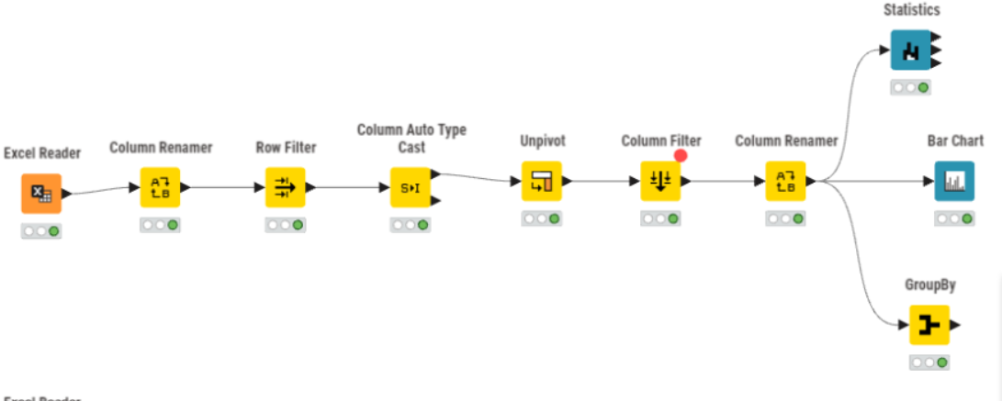
Data Processing – KNIME Workflow

Slide 8
Next Steps
Finalise CSV exports from KNIME for D3 input (trends, age, remoteness, road user)
Begin D3.js scaffolding: load data, set up SVG containers, shared colour constants
Build line chart component first (trends view) - highest priority
Simultaneously complete Figma wireframes for all 4 chart sections

Slide 9
Work In Progress
Completed:
KNIME workflow built - data cleaned, reshaped, aggregated (on GitHub)
Design Book drafted - all sections written
Visualisation design decided - 4 chart types confirmed with justification
Colour palette finalised (navy/amber, colourblind-safe)
In Progress:
Wireframe sketches (Figma)
D3.js setup and first chart build
GitHub Link
https://github.com/Sixxx-cake/Data-Visualisation---Project

Slide 10
Thank you!

